Slide 1

Supplemental Budgets – A Quick Guide
You build your budget based on the best information available at the time.
Unanticipated occurrences may happen after adopting your budget, necessitating a change. The method for making the adjustment to your budget depends on the type of change needed.
Oregon Budget Law allows for supplemental budgets in order to increase appropriations.

Slide 2
Beyond adding appropriations…other uses of Supplemental Budgets
Adding a new fund
Transferring appropriation authority to an appropriation category that doesn’t already exist in the adopted budget
When you don’t need a supplemental:
If the overall budget will not be increased, an appropriation resolution or transfer resolution can be done instead.
Certain changes are exempt from budget law (see p.82 of the TSCC Budget Manual).

Slide 3
Changing Appropriations – Questions to Ask
Does the situation meet supplemental budget justification?
Is the impact to the fund more than 10% of expenditures?

Slide 4
Step 1: Determining if the situation meets Supplemental Budget criteria
ORS 294.471
One or more of the following must be true:
Occurrence or condition not known during the regular budget process
Unforeseen pressing necessity requires prompt action
Unanticipated money from federal, state or local government
Request for services, to be paid for by others
Destruction, involuntary conversion or sale requires immediate replacement
More property taxes received than estimated
Local Option approved in August election
Need to add Debt Service when GO bonds are approved in May election

Slide 5

Step 2: Calculate the 10%
When determining expenditures for a fund, do not include:
×Transfers
×Contingency
×Reserves for future expenditure, or
×Unappropriated Ending Fund Balance

Slide 6
Supplemental Budget Process
Change of 10% or less
• Adopt at a regular meeting (no hearing required)
• Publish notice of the regular meeting, indicating a supplemental budget will be considered (ORS 294.471(3)):
  • At least five days before the meeting
  • In newspaper, by first-class mail or by hand-delivery
  • Include a statement that a supplemental budget will be considered at the meeting
• Adopt supplemental budget by resolution or ordinance
• Resolution must state the need for, the purpose and the amount of the appropriation

Slide 7
Supplemental Budget Process
Change of 10% or more
• Public hearing is required
• Publish notice of the hearing and summary of changes (ORS 294.473):
  • At least 5 days before the hearing
  • In newspaper, by first-class mail or by hand-delivery
  • Notice must summarize changes in each fund changing more than 10%. Include name of fund, source and amount of any changing resources, new appropriation amounts for appropriation changes over 10%, and the fund’s revised total resources and requirements*
• After hearing, adopt the supplemental budget by resolution or ordinance
• Resolution must state the need for, the purpose and the amount of the appropriation
*Dept. of Revenue provides a “Notice of Supplemental Budget Hearing” form

Slide 8
Example Resolution Language - Title
A Resolution Adopting a Supplemental Budget and Making Appropriations for [DISTRICT NAME] for the Fiscal Year Beginning July 1, 20[XX] and Ending June 30, 20[XX]

Slide 9
The [Governing Body] finds that Adopting the Supplement Budget and Making Appropriations is necessary under ORS 294.471. Be it resolved by the [Governing Body] as follows:
That a supplemental budget as set forth in attached Exhibit A is hereby adopted.
That amounts for the purposes shown as in attached Exhibit A are hereby appropriated.
That this supplemental budget is prepared in accordance with ORS 294.471 (1) which authorizes a supplement budget resulting from “An occurrence or condition that is not ascertained when preparing the original budget or a previous supplemental budget for the current year or current budget period and that requires a change in supplemental planning”. This supplemental budget was published and a public hearing held n accordance with ORS 294.471.
Example Resolution Language - Actions

Slide 10
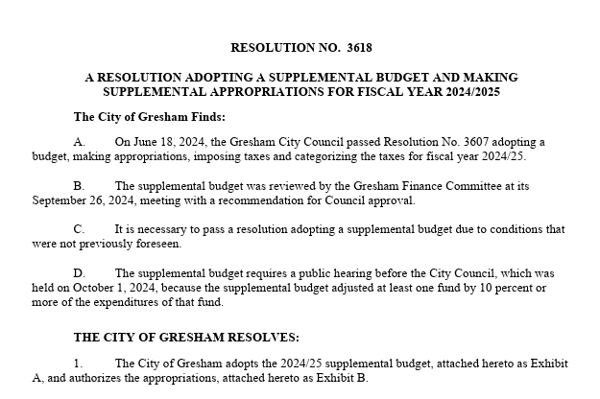

Slide 11
